Slide 1
Lecture 5 - Databases and PHP
Web Development

Slide 2
RoadMap - Next Few Sessions
PHP and MySql
Validating and Sanitizing form data before sending to database
Finishing our login and registration pages
error message handling
Password hashing
Providing user a way of logging out of a session
Making application more dynamic using include files
Incorporate a Products application with CRUD

Slide 3
Outline
Setting up a database table
Making a connection from PHP to a DB
Creating a registration and login page that uses a DB
Before we start extract the zip file on moodle and place under the htdocs directory
This should create lecture5 folder, which is where we will place all our files for today

Slide 4
HeidiSQL
When working with databases, we need have an administration client that will allow us to work with the database.
PHPMyAdmin is one client that you may have seen before as part of your XAMPP installation.

Slide 5
HeidiSQL
Instead of using PHPMyAdmin, we will use a client called HeidiSQL.
Heidi can be downloaded from: http://www.heidisql.com
Download and install this piece of software!

Slide 6
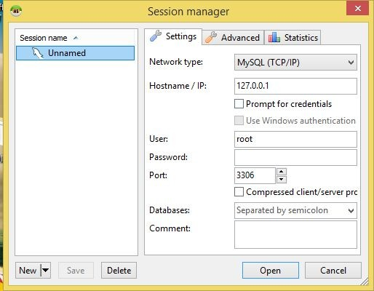
HeidiSQL
Note localhost and 127.0.0.1 are interchangable, the latter being the ip address of localhost
When you open Heidi, you will see that you can add the
details of the database you are running with your XAMPP.
Make sure that these details are the ones
for your local database! (see next slide)
Give the session a name e.g. Lecture 5

Slide 7
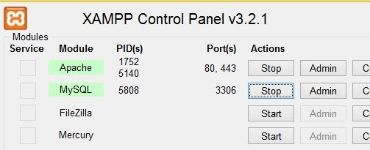
Checking the port number
If you want to know what port you need to use for MySQL, check the port number on your XAMPP console
In this case, you can see my database is running on port 3306.
Login Details
The username by default is root for the username, and nothing for the password, just leave it blank. We use 127.0.0.1 for the database address, because the database is running on our local machines.

Slide 8
HeidiSQL
After you have entered in your details click “Open” and a new connection to the database will be opened.

Slide 9
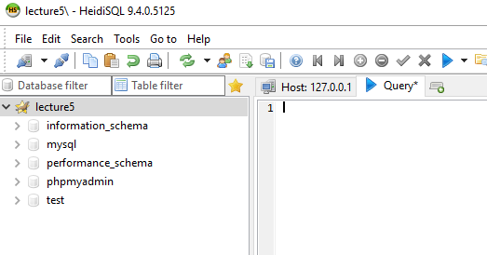
Creating the database
When Heidi opens,
on the left hand side, you will see the list of databases.
We’ll start by adding a new database.
Right click on the session and select Create new > Database
Enter “wdtest” as the database name

Slide 10
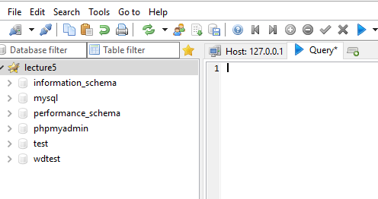
Adding the table SQL
Select “wdtest” as your database by clicking on it
Then Click on the blue tab, for Query
When you are inside the query tab, copy the contents of the SQL from the dbusers.txt file in lecture5 folder and paste it into the text box.

Slide 11
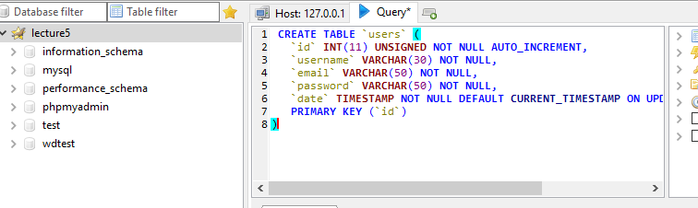
Adding the table SQL

Slide 12
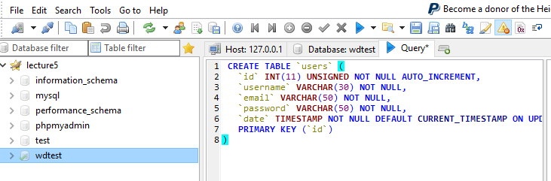
Run the SQL
To finish, all we need to do is run this code, by clicking the Run button

Slide 13
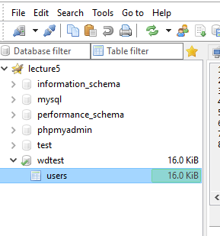
That’s it!
You will see a new table has been created in your database.

Slide 14
Back To PHP
Now that we have created our website, we need to add two pages:
1 page for registering 1 page for logging in

Slide 15
Remember!
Do not cut and paste things from the lecture notes, lots of hidden characters will appear in your code causing problems.
Use the file examples on Moodle! Or type in the code yourself

Slide 16
Register Page
We are going to allow the user to type in a username, email and password, and then allow them to click a register button.

Slide 17
Register.php
Below is what the form looks like. We have three fields, username, email and password. One submit button is added to this form also.
<!DOCTYPE>
<html>
<body>
<h2> Registration Form</h2>
<form action="register.php" method="post">
Username <input type="text" name="username"/>
Email <input type="text" name="email"/>
Password <input type="password" name="password"/>
<input type="submit"/>
</form>
</body>
</html>
Create a new file and save it as register.php in the lecture5 folder
This file is registerhtml.txt in the lecture5 folder

Slide 18
Exception Handling
We need some way of capturing errors when running PHP code. Its very similar to JAVA.
We use a try/catch statement
Inside the try statement is the code we want to execute
Inside the catch we do some error handling
try{
//code that may throw exception
}catch(Exception_class_Name ref){
//error handling
}

Slide 19
Register.php
Just above the form, we will add some PHP to collect the username,email and password and then send them to the database to be saved.

Slide 20
If here is the same as $_SERVER[‘REQUESTST_METHOD’] == “POST”
<?php if($_POST){
// $_POST will have no value if not come from form post
$username = $_POST['username'];
$password = $_POST['password'];
$email = $_POST[‘email’];
Code for this can be found in the registerA.txt file
try {
$host = '127.0.0.1';
$dbname = 'wdtest';
$user = 'root';
$pass = '';
# MySQL with PDO_MYSQL
$DBH = new PDO("mysql:host=$host;dbname=$dbname", $user, $pass);
} catch(PDOException $e) {echo 'Error';}
Get the username, email and password and store them into variables called $username, $email and $password
Make a DB connection
}
?>

Slide 21
Making a connection with PDO
The line that makes the DB connection is below:
$DBH = new PDO("mysql:host=$host;dbname=$dbname", $user, $pass);
We are passing the following parameters
$host : address for the database
$dbname : the name of the database, in our case the wdtest database
$user : the username for the account we are using
$pass : the password for the account.
All of these details are being passed to an instance of the PDO class, which stands for Prepared Data Object

Slide 22
PDO
Once we have the PDO instance we have available a whole bunch of functions (or methods) to help us interact with the mysql database:
- prepare() prepare our sql statement
- bindParam() bind input variables to sql statement
- execute() execute the sql statement
- fetch() fetch single row from result of execute
- query() run a direct sql statement in no params
- rowCount() number of rows returned from execute
- fetchAll() returns all rows in a query
- fetchColumn() return single column from query

Slide 23
PDO
PDO stands for PHP Data Objects, an advanced approach to connect to database not only mysql but several others. Here is a list of database supported by PDO-
Micro Soft SQL Server
MySQL
PostgreSQL
Oracle
Sqlite
IBM DB2
Firebird
INFORMIX etc.

Slide 24
PDO
The real PDO benefits are:
security (usable prepared statements)
usability (many helper functions to automate routine operations)
reusability (unified API to access multitude of databases, from SQLite to Oracle)
The PDO extension defines a lightweight, consistent interface for accessing databases in PHP. It means that, regardless of which database you're using, use the same functions to issue queries and fetch data. There is no need to rewrite your queries again when you change your database.

Slide 25
Insert statement preparation
Insert code just under the $DHB statement. This code can be found in the registerB.txt file
$sql = "INSERT INTO users (username, password,email) VALUES (?, ?, ?);";
$sth = $DBH->prepare($sql);
$sth->bindParam(1, $username);
$sth->bindParam(2, $passwordl);
$sth->bindParam(3, $email);
$sth->execute();
Standard SQL insert statement. We are inserting into the users table.
echo 'You are now registered!';
Notice how we are not passing the variables, we are passing a question mark. This is because, on the line below, we are passing variables 1, 2 and 3 later in the bind statement

Slide 26
bindParam()
We use the bindParam function to pass the variables into the statement. We do this because we don’t want to allow people to put their own content into the SQL statement because it can lead to SQL injection! (more later)
We prepare the statement, and
then bind the parameters to the statement.

Slide 27
Register.php
When the user enters in their username, email and password and clicks the button, a new record will then be inserted into the database table.
Lets try it. Bring up the register.php file in the browser i.e.
localhost/lecture5/register.php

Slide 28
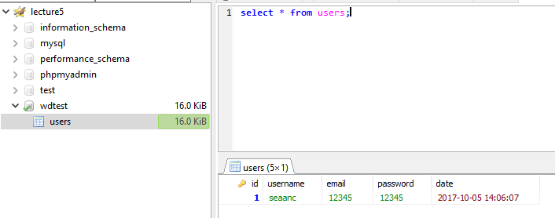
Register.php
If successful go back to Heidi and see if your record had been added

Slide 29
Logging In
Now that we have a record inserted into the database, we can now look at the login.php page.
This page will allow the user to enter in their username and password and click Login.

Slide 30
Login.php
When they click login, we want to check the database to see if what the user entered is what we have stored in the database.

Slide 31
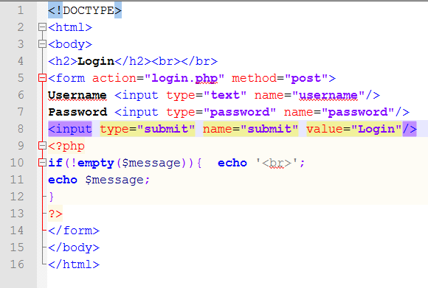
Login.php
Create a new file and add this content. Save as login.php in the lecture5 folder. Can see in loginhtml.txt
Checks if a message string is not empty. Used to display message to the user. Set in database php code to follow

Slide 32
Just above the form we add this..
<?php if($_POST){
$username = $_POST['username'];
$password = $_POST['password'];
try {
$host = '127.0.0.1';
$dbname = 'wdtest';
$user = 'root';
$pass = '';
# MySQL with PDO_MYSQL
$DBH = new PDO("mysql:host=$host;dbname=$dbname", $user, $pass);
} catch(PDOException $e) {echo 'Error';}
This code is the same as the register.php code. Can copy from registerA.txt, just remove the email reference
}
?>

Slide 33
Named Placeholders
This next example uses what we call named placeholders. We give a name, and then give the value later on. Named placeholders look like this
:name

Slide 34
$q = $DBH->prepare("select * from user where username = :username and password = :password LIMIT 1");
$q->bindValue(':username', $username);
$q->bindValue(':password', $password);
$q->execute();
$row = $q->fetch(PDO::FETCH_ASSOC);
This uses “named” place holders, we just give a little nickname to the variables
//returns table row as an associative array
//of values column names to data values
//Array ( [id] => 1 [username] => seaanc
// [email] => 12345 [password] => 12345 [date] => 2017-10-05 14:06:07 )
$message = “”;;
if (!empty($row)){
$username = $row['username'];
This file is loginB.txt in the lecture5 folder. Add code after the $DBH statement
$message = 'Loggin in!';
} else {
$message= 'Sorry your log in details are not correct';
}

Slide 35
What happens?
If everything goes ok, the user will login.
If the details are not correct, it will print an error message to the screen.

Slide 36
Security
One of the big issues with allowing people to insert or select records from forms directly to the database is SQL injection.
SQL injection is when someone adds some SQL into a form field, e.g. the username field with malicious intent to break a database.

Slide 37
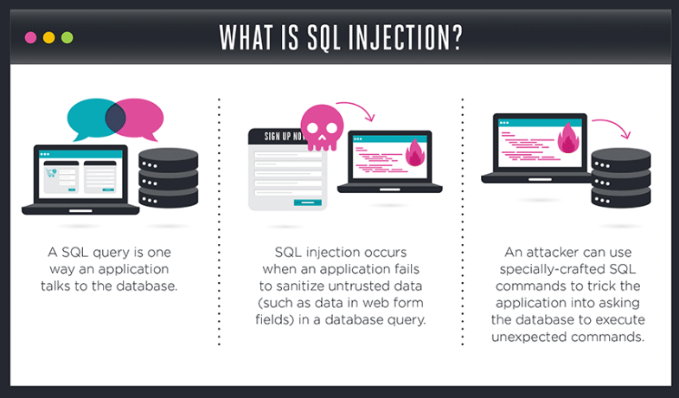
SQL Injection

Slide 38
Security
When the insert statement goes to add the username and password into the database, a person may inject some SQL themselves such as:
‘DROP TABLE users;’
Via an input element on the form

Slide 39
SQL Injection
SQL injection is a code injection technique, used to attack data-driven applications, in which nefarious SQL statements are inserted into an entry field for execution (e.g. to dump the database contents to the attacker).
Entered via form
$name = "Bobby';DROP TABLE users; ";
$query = "SELECT * FROM users WHERE name='$name'";
which compiles into malicious sequence
SELECT * FROM users WHERE name='Bobby';DROP TABLE users;
Previous versions of php mysql libraries would allow you to set up a query like this

Slide 40
Named Placeholders
If we use PDOs to do our insert statements, and our select statements with named placeholders, or positional(?) place holders we can help prevent SQL Injection
If we don’t use prepared statements like in the previous slide example we would be required to do more work to sanitize the data before issuing the query

Slide 41
PDO::bindParam() //returns true or false
Binds a PHP variable to a corresponding named or question mark placeholder in the SQL statement that was used to prepare the statement.
Note that PDO supports positional (?) and named (:email) placeholders, the latter always begins from a colon and can be written using letters, digits and underscores only. Also note that no quotes have to be ever used around placeholders.

Slide 42
Named Placeholder
<?php
/* Execute a prepared statement by binding PHP variables */
$calories = 150;
$colour = 'red';
$sth = $dbh->prepare('SELECT name, colour, calories
FROM fruit
WHERE calories < :calories AND colour = :colour');
$sth->bindParam(':calories', $calories);
$sth->bindParam(':colour', $colour);
$sth->execute();
?>

Slide 43
Positional Placeholder
<?php
/* Execute a prepared statement by binding PHP variables */
$calories = 150;
$colour = 'red';
$sth = $dbh->prepare('SELECT name, colour, calories
FROM fruit
WHERE calories < ? AND colour = ?');
$sth->bindParam(1, $calories);
$sth->bindParam(2, $colour);
$sth->execute();

Slide 44
"bindParam" comes into action, binding placeholders to user entered data.
Notice that bindParam only binds data to placeholders leaving unchanged the query. So there is no way to change the original SQL query, because it has already sent to the server by means of the prepare method and because you are sending SQL queries and input data separately so user entered data can't interfere with queries.
This allows SQL to insert the values into the expression, without modifying the expression itself.
So you would not be able to do something like
$name = "Bobby';DROP TABLE users; ";
It simply becomes a search string rather than becoming part of the query i..e we would be searching for a name of
"Bobby';DROP TABLE users; "
Which would be meaningless but harmless

Slide 45
Add Some style
There is a css file on the moodle page called style.css. Download and place in your folder
We will add it to the html of both pages. Add the html to load the css
<head>
<link rel="stylesheet" href="style.css">
</head>
After the <html> tag in both files
We now need to add the class attributes from the css to the form and input submit button

Slide 46
Add Some style
Add to both files
register.php
And
login.php
To the form tag we add the class attribute
<form class='form-style'................
To the submit button we add the class attribute so that
<input type="submit" class='button' …………………

Slide 47
Homework
Using the application we’ve worked on add the following functionality
Add a confirmation page to the application, say confirm.php
From the register.php file and the login.php files if we successfully
store and retrieve a record to/from the database re-route to this new confirmation page using the header function
Store session data before rerouting for the username and email and display it in the new confirmation page.
Store a message via session variable “thank you for registering”.$username if coming from register.php
Don’t forget to add start_session() to the top of each page.

Slide 48
Homework
Check that a session variable exists for username before printing the session variables in confirm.php else re-route to login.php
Print register message
if appropriate session variable set
print register message
else
print “Logged in as: “.$username

